Slide 1
November 6, 2024
MEGA Market Update

Slide 2

Mark LaVigne
Executive Director
MEGA

Slide 3
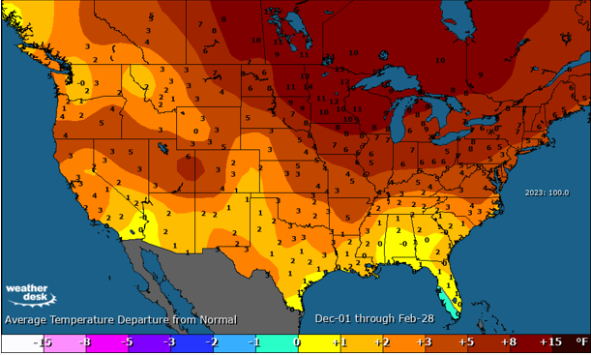
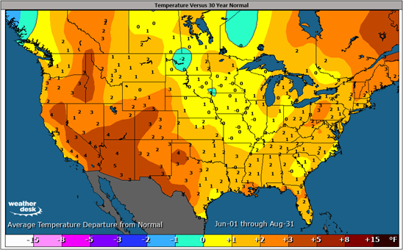
Weather Review – National vs. NYISO
Winter 2023/2024 Temperature Departures
Summer 2024 Temperature Departures
Warmest winter since 1950
5th warmest summer since 1950
NYISO: 2591 GWCDDS
NYISO: 758 PWCDDs
ABOVE average winter
ABOVE average summer

Slide 4
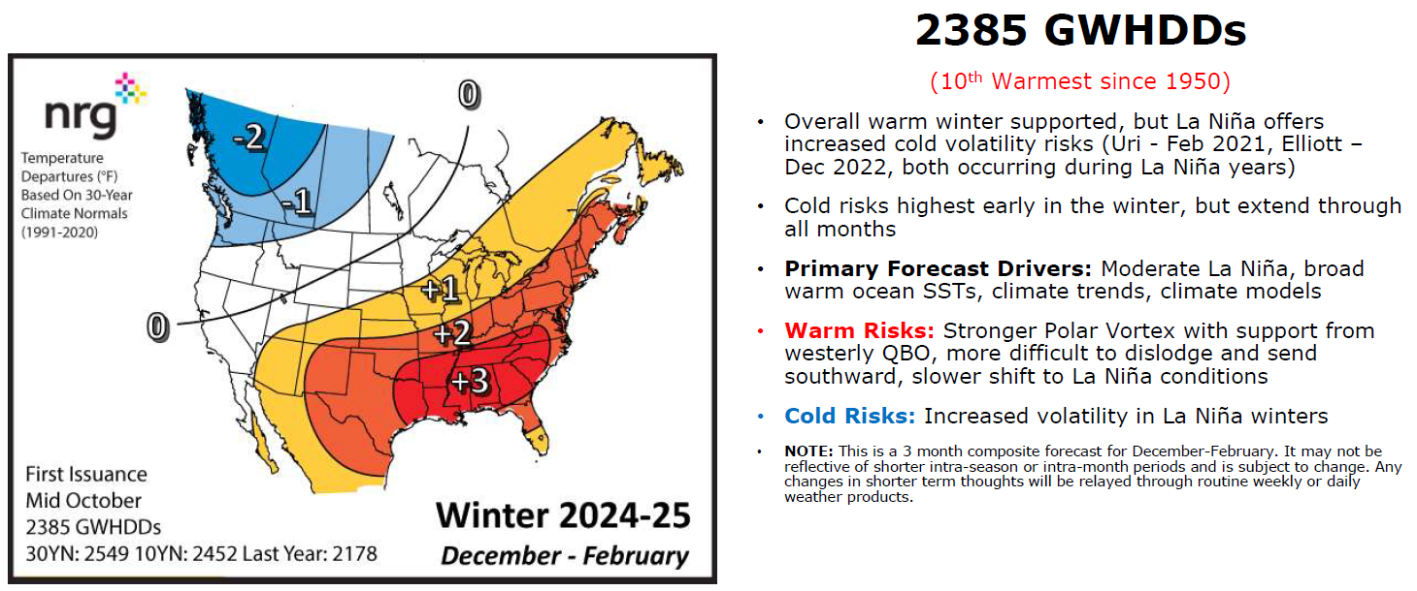
NRG 2024-25 Winter Outlook

Slide 5
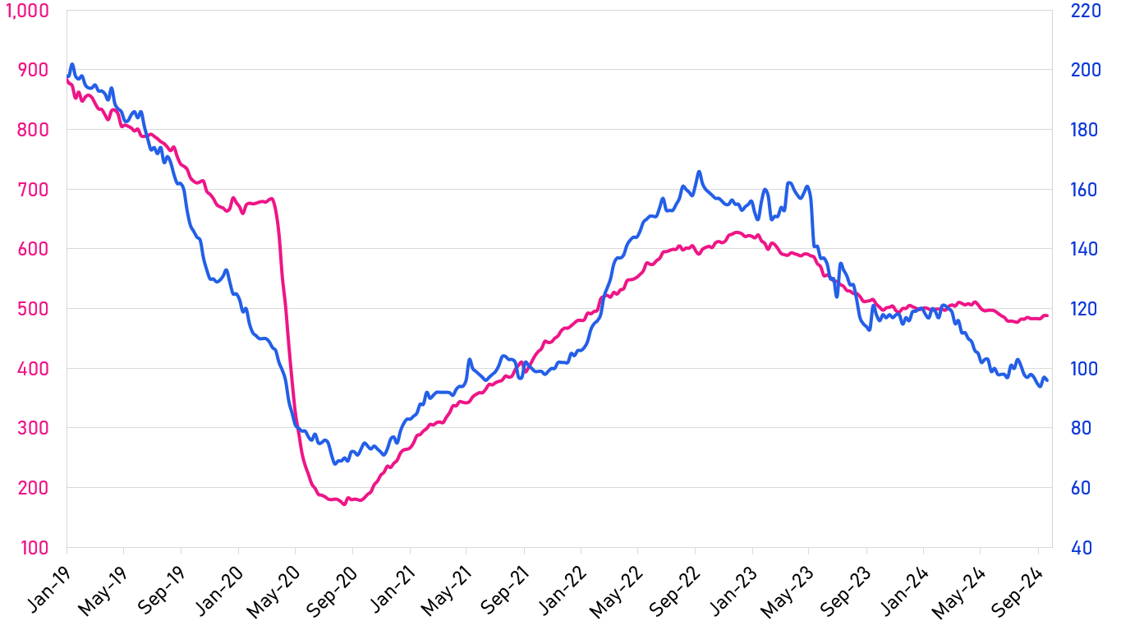
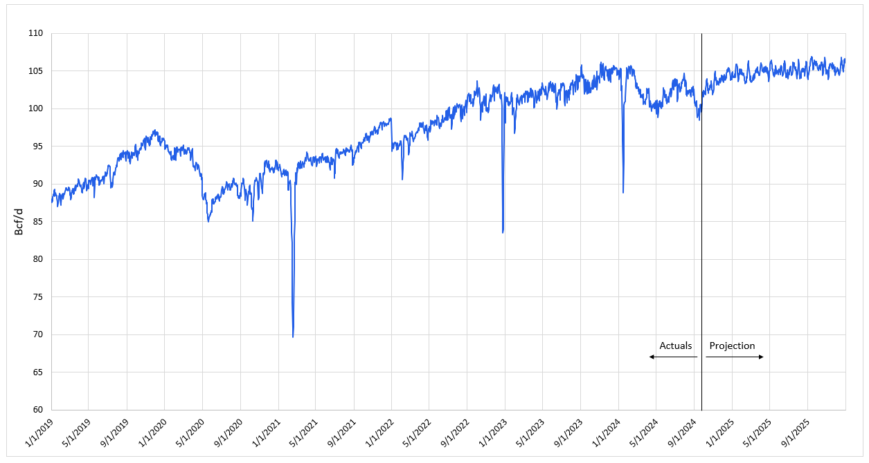
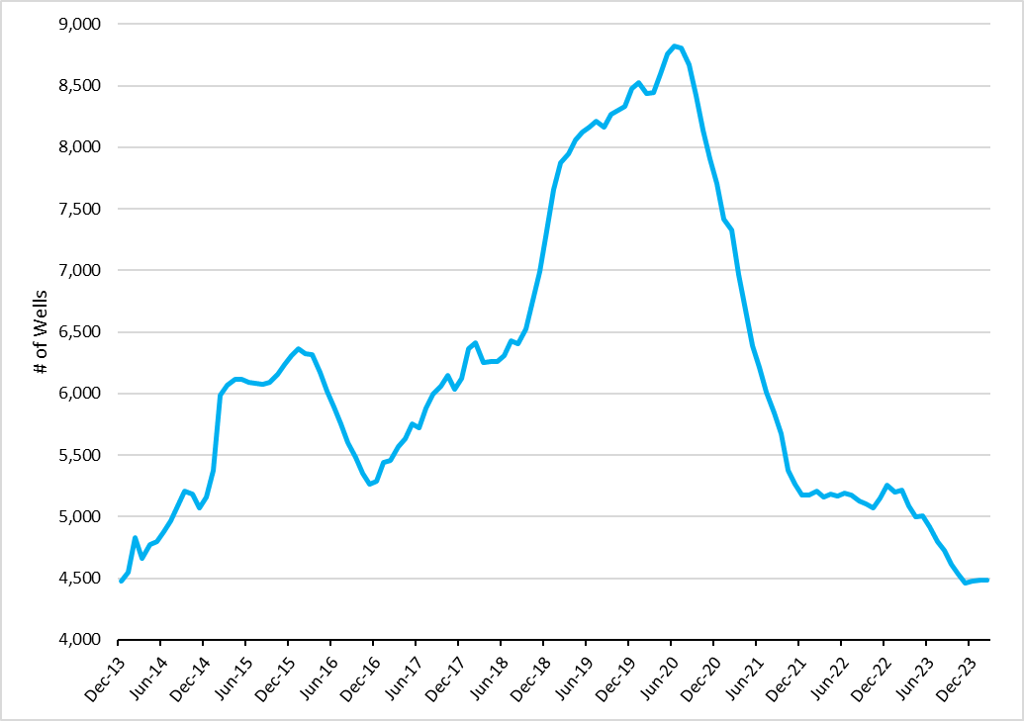
Domestic Natural Gas Production
Rig Count
Historical Production & Forecast
Oil Rigs
(Left Axis)
Natural Gas Rigs
(Right Axis)
S&P Global Data
Actual – Based on S&P Global Data
Projection - Based on EIA Data
DUC Wells
DUC Wells are partially completed sources of supply
Supply from these wells can be quickly brought to market at a lower cost than new drills
Due to the depressed pricing environment, many producers have implemented strategic curtailments throughout the past two months, and is likely to continue.
EQT, Apache, Chesapeake Energy, Rivals Antero Resources Corp, EGO Resources, Coterra Energy, and more.
EIA Data
Notes:
https://www.reuters.com/markets/commodities/us-natural-gas-producers-eye-more-output-cuts-prices-sink-2024-08-07/
Most producers planning for production cuts in September – October timeframe if pricing environment remains depressed. Could they extend cuts beyond October?
Rig count trends are a crucial metric in the oil and gas industry for several reasons:
Indicator of Future Production: The rig count is a leading indicator of future oil and gas production. When the rig count increases, it suggests that more wells are being drilled, which typically leads to higher future production¹.
Economic Health: Rig counts can reflect the economic health of the oil and gas sector. A higher rig count often indicates increased investment and activity in the industry, which can be a sign of economic growth².
Market Sentiment: Changes in rig counts can influence market sentiment and oil prices. For example, a rising rig count might signal an oversupply, potentially leading to lower prices, while a declining rig count might indicate reduced supply, which can drive prices up³.
Employment and Services Demand: The number of active rigs affects employment levels and the demand for services and equipment in the drilling industry. More rigs mean more jobs and higher demand for related services⁴.
Regional Insights: Rig count trends can provide insights into regional activity. For instance, a rise in rig counts in a specific area can indicate a boom in that region’s oil and gas industry².
DUC wells, or Drilled but Uncompleted wells, are oil and natural gas wells that have been drilled but have not yet undergone the final steps needed to start production¹. These steps include casing, cementing, perforating, and hydraulic fracturing¹.
Key points about DUC wells:
Flexibility: They provide oil and gas companies with flexibility. By having a backlog of DUC wells, companies can quickly ramp up production when market conditions are favorable without the delay of drilling new wells².
Cost Efficiency: Completing a DUC well is generally less expensive and faster than drilling a new well from scratch².
Market Strategy: Companies often use DUC wells as a strategic reserve to manage production levels and respond to market demand³.

Slide 6
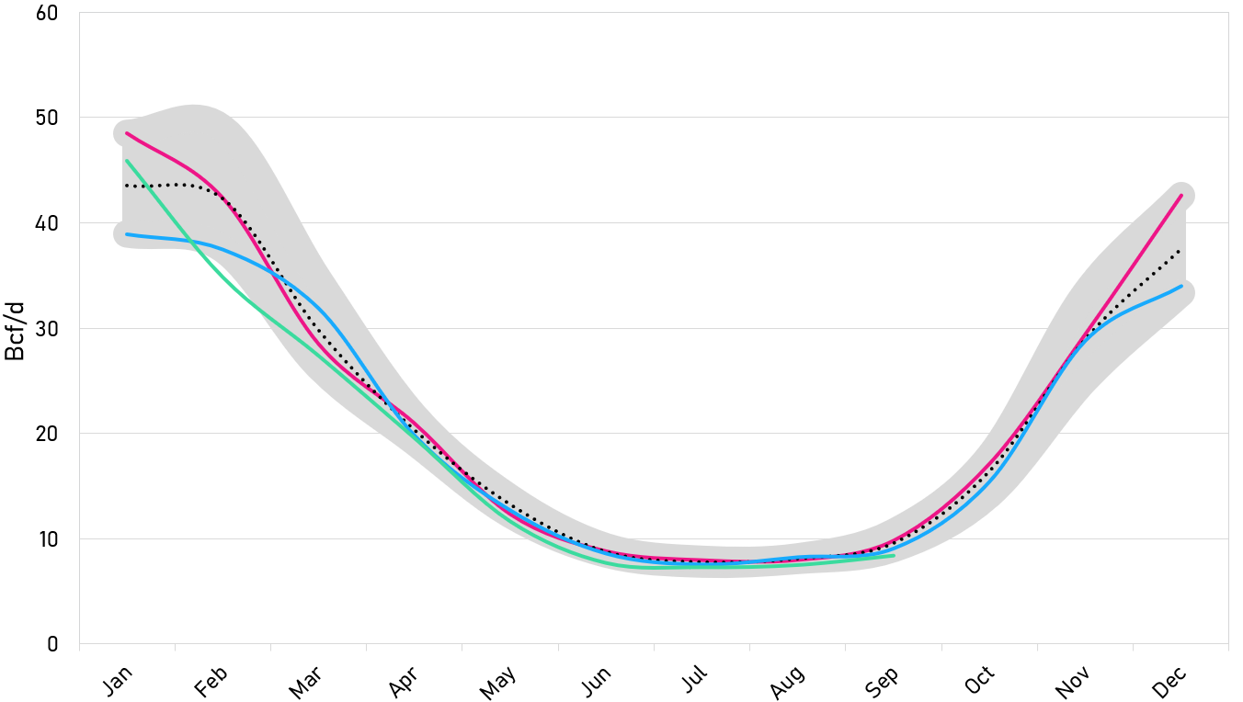
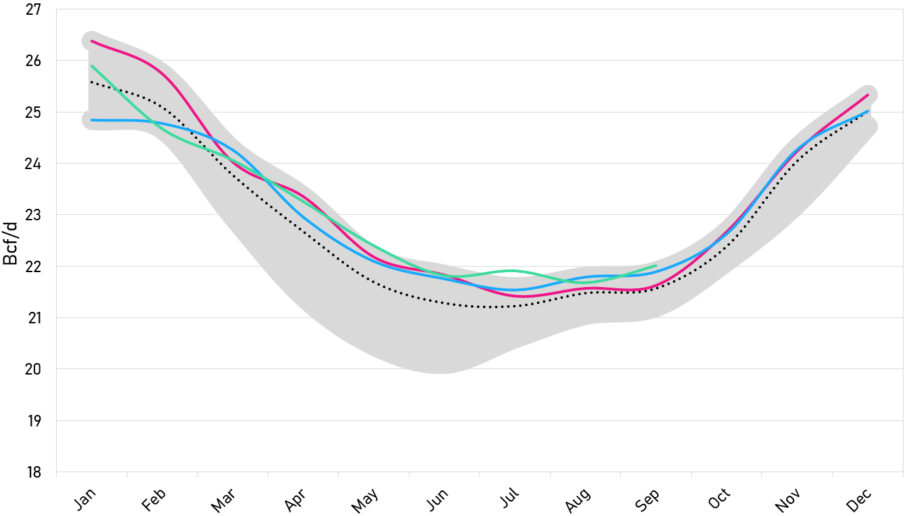
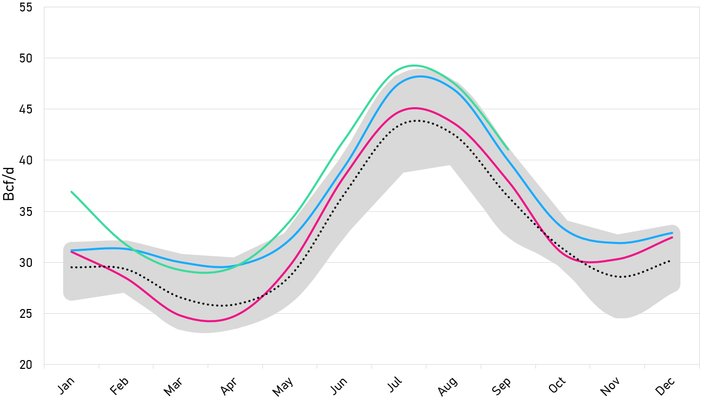
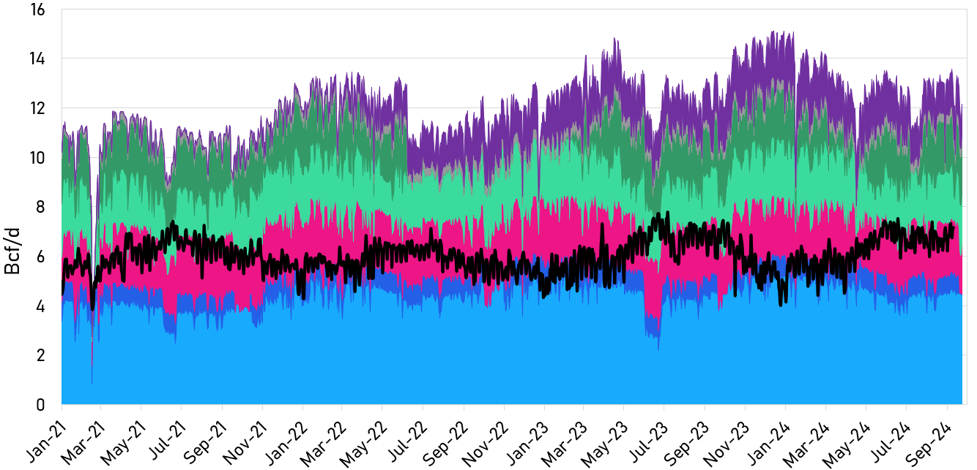
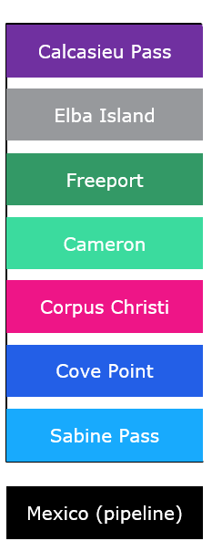
Total Natural Gas Demand with Exports
Res/Com Demand
Industrial Demand
Power Burn Demand
Elevated power burn demands have continued through the fall season with bearish above-average temperatures.
LNG exports mostly flat YTD, could pick up in coming months from global economics and capacity growth
Production cuts and continued high demand for NG could continue; winter weather to play a key role in supply/demand balance for end of withdrawal season
S&P Global Data
Notes:
High Power burn Demand – 2nd hottest summer, low wind generation in TX (Aug)
LNG ST Growth – Bullish Global Price environment to prep for Winter Storage
LNG LT Growth – LNG Export capacity growth ~ 5 BCF/d of growth expected over Cal 2025

Slide 7
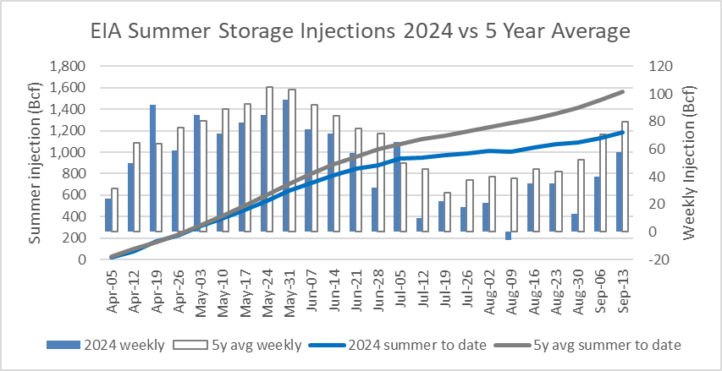
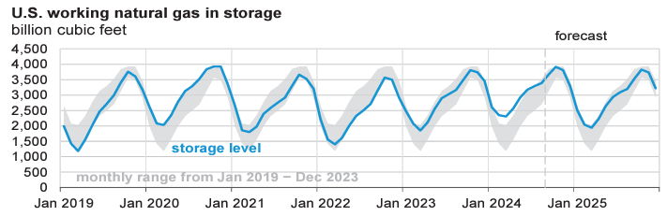
Natural Gas Storage & Projections
Supply/demand balance remains healthy from the lower demand and high production seen throughout most of summer.
Storage surplus has kept a cap on near-term price volatility year-to-date.
Notes:
EIA forecasting a tighter supply-demand balance over the coming winter – leading to lower underground storage levels at the exit of winter ~ March 2025
Exited Winter 23/24 at ~+25% vs PY, +40% vs 5YA – production cuts and high demand have led to shrinking surplus (+6% PY, +11% 5YA) – End of Aug

Slide 8
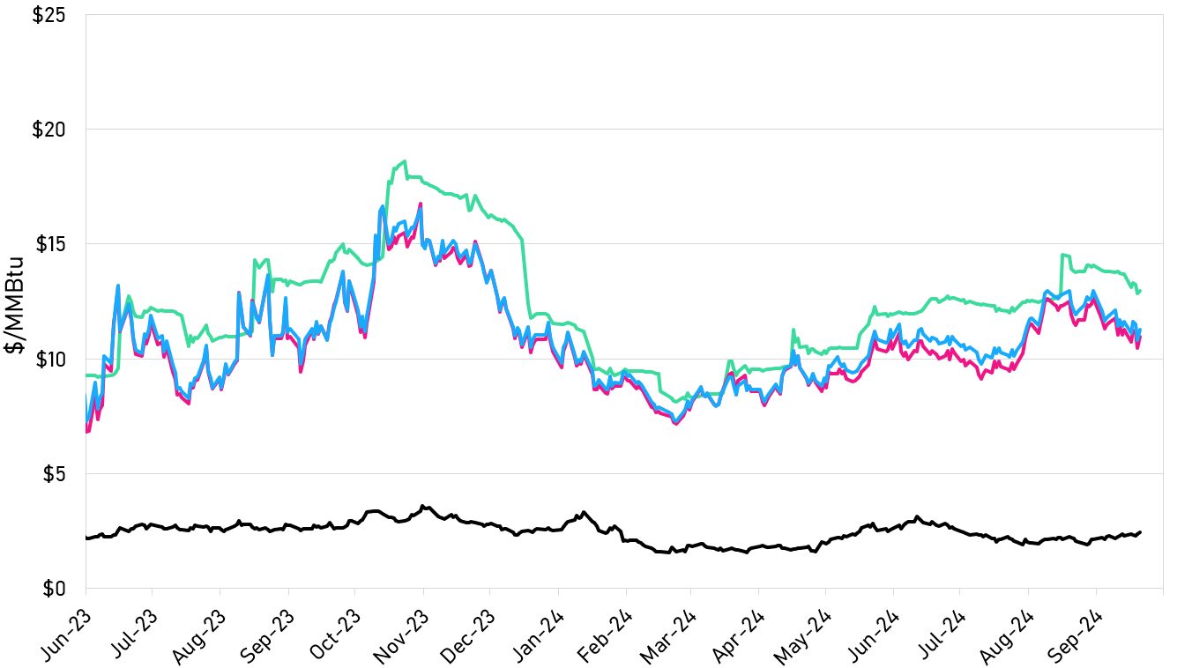
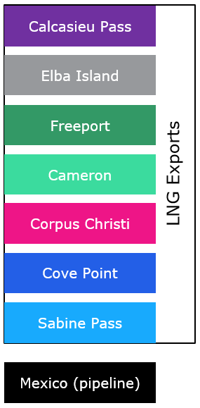
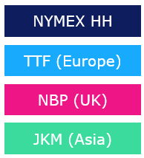
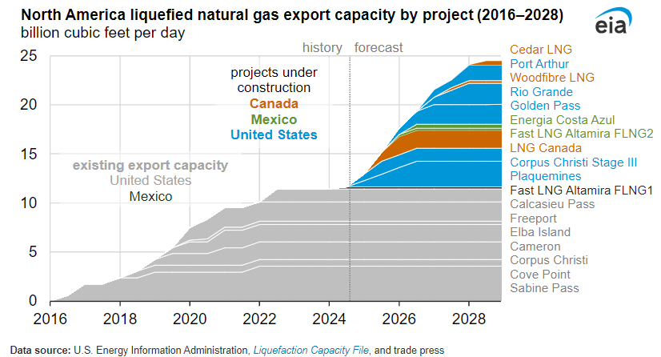
U.S. LNG Growth Outlook
Prompt Month Prices – NYMEX vs Global LNG
U.S. Natural Gas Exports
S&P Global Data
S&P Global Data
European storage levels ~93% full; weather risk could lead to short-term demand elevation
Current LNG demand trending lower due to partial outages; demand could rise in coming weeks
North American LNG export capacity on track to more than double by 2028
Notes:
Global indices on rise – could drive a return of near-term demand
LNG Terminal Delays: Golden Pass, what is the other one?

Slide 9
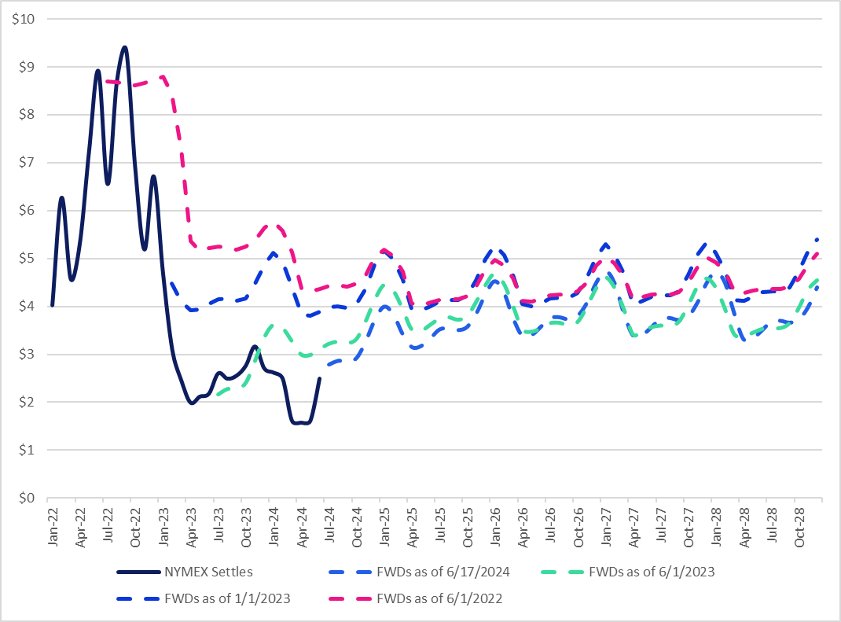
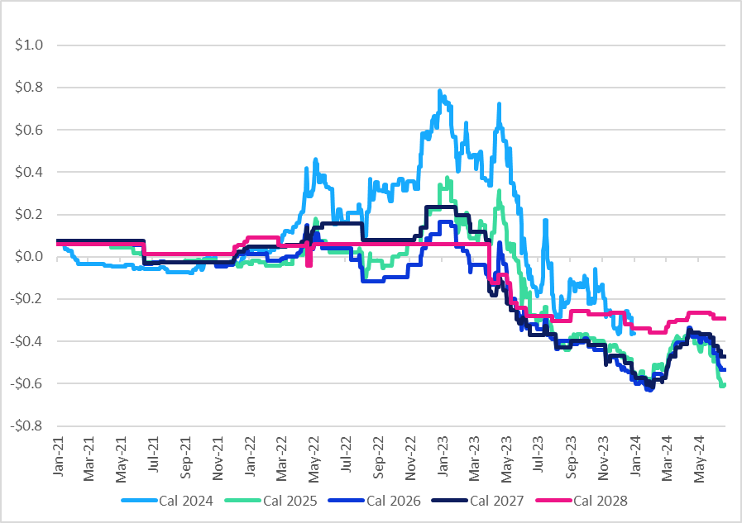
NYMEX and Regional Gas Price Trends
NYMEX Curve Forwards and Settles
Transco Zone 6 NY Basis
$/MMBtu
$/MMBtu
Notes:
As the market has settled month to month, we have been in an environment where settlements are coming in very low compared to forwards.
Speak to NY basis levels here
seasonal impacts and volatility
delivered price has come down and underpriced coming out of recent winter for Algonquin and IRQz2.

Slide 10
Regional Energy Considerations
East/Midcon
Northeast
Texas/West
  Healthy regional gas in storage
  MVP continues to ramp, currently ~50% operating capacity
  Fall season has experienced bearish above-average temperatures.
  Weather risk – Increased volatility in La Niña winters
  Global LNG prices have softened, which puts downward pressure on gas basis prices and, in turn, electric prices in the Northeast
  Algonquin Gas Transmission Rate Case – possible 218% increase
  Last winter for ISO-NE’s Inventoried Energy Program
  Entire Vineyard Wind project offline due to a turbine blade failure
  California gas storage continues to trend at a healthy surplus compared to historical averages
  New Costa Azul LNG facility in Mexico delayed from Summer 2025 to Spring 2026
  High renewable output, battery storage, and milder weather have resulted in low index clears for Summer 2024
  Significant load growth continues to play a part in long-term fundamentals
Notes:
East/Midcon
Winter weather risk – If production remains low and demand starts to rise, will this tighten the balance over peak gas demand season?
California
Gas:
California gas storage continues to trend at a healthy surplus compared to historical averages (bearish)
New Costa Azul LNG facility in MX delayed from Summer 2025 to Spring 2026, reduces basis price pressure for next summer (bearish)
Change in BTS rate schedule to volumetric effective Dec’24, likely to add price support to SoCal basis (bullish)
Power:
California resource adequacy and renewable energy prices remain volatile; Slice of Day implementation on track for Jan’25 (bullish)
Growing duck belly creating very low, to negative, energy prices during the day with steeper early evening ramps (bullish – steeper ramp and bearish – growing duck belly)
+2GW of additional battery generation year-over-year fueling the grid (bearish)
Texas
Higher renewable and power storage participation in the energy market, coupled with milder weather, has resulted in lower index clears for Summer 2024
Significant forecasted load growth continues to play a part in longer-term fundamentals stemming from growth in data centers, industrial load, and residential population.
Solar generation set a new output record on 8/18 at 20.8 GW
Power storage generation set a new output record on 8/20 at 3.9 GW

Slide 11
2024
Curtailment Incentives

Slide 12
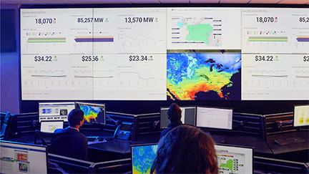
What is Demand Response?
Demand Response (or “DR”) is an energy curtailment program offered across the United States by grid operators. DR programs pay large electricity users when they have the operational flexibility to reduce their usage during system peaks.
Demand Response Objectives
Improve local reliability while ensuring grid stability and resiliency
Defer or eliminate the need for new natural gas-fired generation plants
Reduce market price spikes
Access affordable and reliable resources to meet future demand

Slide 13






Demand Response from Start to Finish
Metering
Reduction Action Plan
Activation
Notification
Performance
Payment
For eligible customers, NRG installs or upgrades a meter to track customer electricity usage in real-time, providing NRG with:
Interval data for M&V purposes
Customer access to interval demands & kWh usage
Customer tools to better manage day-to-day operations
NRG works with customers to create a realistic way to curtail based on their facility’s operations and maximize the customer’s payment opportunity.
The electric grid operator will experience a crisis, or predict a shortage in supply for expected demand.
The operator or utility company will alert NRG of the need for an emergency DR event.
NRG calls on participating companies to reduce their electricity use to keep the grid stable.
Once notified, companies will implement their RAP, utilizing appropriate personnel for execution.
Customer performance is determined by one of the following methods:
How much electric demand is reduced from a previously calculated baseline
Reduction measured against demand peak hours from the prior year, weeks, days, or hours
After the conclusion of
the DR season, customers are paid for their participation.

Slide 14

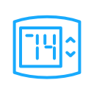



Common Reduction Strategies
General Strategies
Notify all personnel involved in
DR reductions to prepare for the event. Alert patients, residents and visitors of the event and about your facility’s participation.
Elevators
If there is more than one elevator, take some elevators offline as long as they are within building and safety codes.
HVAC
10-15 minutes before the start of the event, turn off the units completely or raise the temperature set points as high as 80°F.
Misc. Equipment
Plug load should be turned off and unplugged as appropriate. This includes vending machines, photocopiers, etc.
Lighting
Shut off all lighting in unoccupied areas and areas that have sufficient natural lighting. Reduce lights in areas where lighting cannot be fully shut off.
Generators
If there is a generator available for use, it should be engaged 10-minutes before the event start time and kept operating 10-minutes after the event end time.

Slide 15
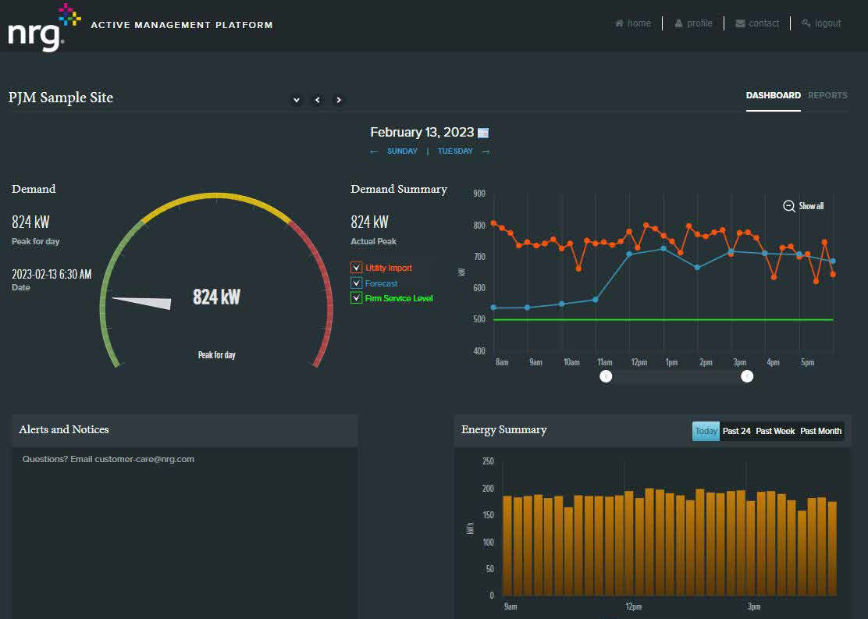

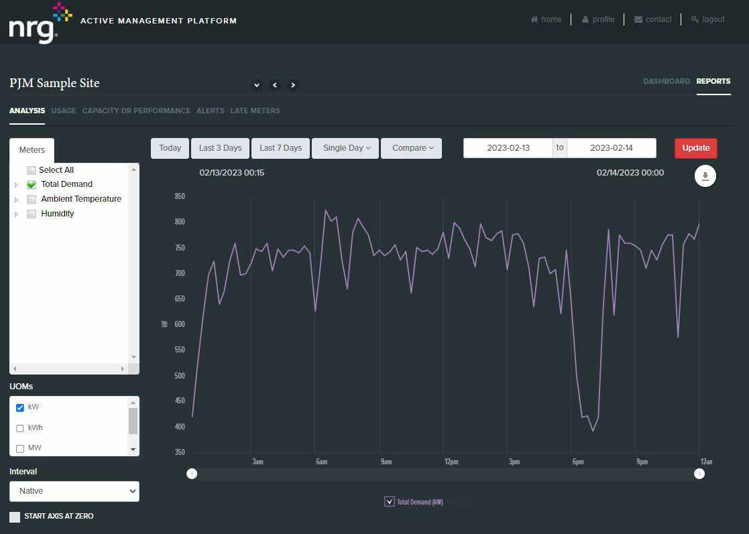
Active Management Platform (AMP)
AMP puts a wealth of information right at your fingertips. With AMP, NRG Demand Response customers can access their own portal with valuable information about usage and program performance.
KNOWLEDGE
Understand how your business consumes energy and make more informed decisions.
Visualize the impact of your load reduction activities with near real-time consumption data
Understand your current consumption behaviors as compared to your established baseline – zoom in to specific time periods for more detail
Export reports into various formats
PERSONALIZATION
Create and leverage your own reporting tools and analysis
Build personalized reports with filters for time of day, calendar strips, interval length, sites, and generation assets
Set alerts for specific operational conditions and AMP will send you an e-mail when conditions are met

Slide 16
NYISO Programs and Products

Slide 17
Special Case Resource (SCR)
Main NY program administered by the NYISO
Program | Special Case Resource (SCR)
Duration/Seasons | Summer: May - October Winter: November - April
Call-Hour Window | 24/7 Monday through Sunday, excluding holidays
Baseline | ACL (Average Coincidental Load); Static
Event Trigger | Grid Conditions/System Peaks
Event Limits | Unlimited
Event Notice | Day-ahead standby by 3:00 P.M. or 24-hours; 2-hour day-of confirmation
Event Duration | Unlimited
Test Requirement | 1-hour test in each season Summer: between August 15 – September 7 Winter: between February 15 – March 7

Slide 18


Event History: SCR
2021
2022
2023
1-Hour Test
Zone F
7/19 → 6hrs
7/20 → 7hrs
1-Hour Test
1-Hour Test
February 16
September 1
February 16
August 24
February 22
August 30
Emergency Events
Zone J
  6/29 → 7hrs
  6/30 → 6hrs
Zone K
  8/11 – 8/13 → 6hrs
  8/25 – 8/27 → 7hrs
Emergency Events
Zone F
7/19 → 6hrs
7/20 → 7hrs
No Emergency
Events

Slide 19
Sample Demand Response Revenue - NY
A 1 MW Customer in the NYISO SCR program has the potential to earn:
NY Zone | Estimated Annual Revenue Summer | Estimated Annual Revenue Winter
NYC | $47,515 | $39,000
Long Island | $16,464 | $10,856
Rest of State | $13,055 | $9,133
GHI | $13,770 | $9,413
NOTE: Revenue is indicative and based on historical blended rates for NY market
*Based on a 75% customer split – split will vary on a customer-by-customer basis.
*Summer pricing based on Summer of 2024.Winter pricing is based on Winter of 2023.

Slide 20
Commercial System Relief Program (CSRP)
Supplemental NY program run through the utilities
Program | Commercial System Relief Program (CSRP)
Participating Utilities | Central Hudson (CHG), Orange and Rockland (ORU), PSEG Long Island (PSEG LI), Rochester Gas and Electric (RGE), New York State Electric & Gas (NYSEG), National Grid, Consolidated Edison (ConEd)
Duration/Seasons | Summer-only: May – September *Central Hudson: June - September
Call-Hour Window | 11 AM – 11 PM, Monday – Friday, excluding holidays
Baseline | Rolling; non-static
Event Trigger | Specific percentage of forecasted summer system-wide peak load being met 92%: National Grid, NYSEG, ORU, ConEd, PSEG LI 97%: CHG, RGE
Event Limits | Unlimited
Event Notice | 21-hour day-ahead notice; 2-hour day-of notice
Event Duration | Four hours
Test Requirement | At least (1) 1-hour test per year

Slide 21
Sample Demand Response Revenue – NY
A 1 MW Customer in the CSRP program in NY has the potential to earn:
Utility | Estimated Annual Revenue Summer Only
National Grid | $10,312
NYSEG | $15,375
RGE | $15,937
Central Hudson | $ 4,612
Orange & Rockland | $11,250
PSEG Long Island | $18,750
Con Edison – Staten Island/Westchester | $22,500
Con Edison – Other Locales | $67,500
NOTE: Revenue is indicative and based on historical blended rates for NY market

Slide 22
Q & A

