Slide 1



Options and Benefits of
County-Sponsored Defensive Driving
Classes

Slide 2
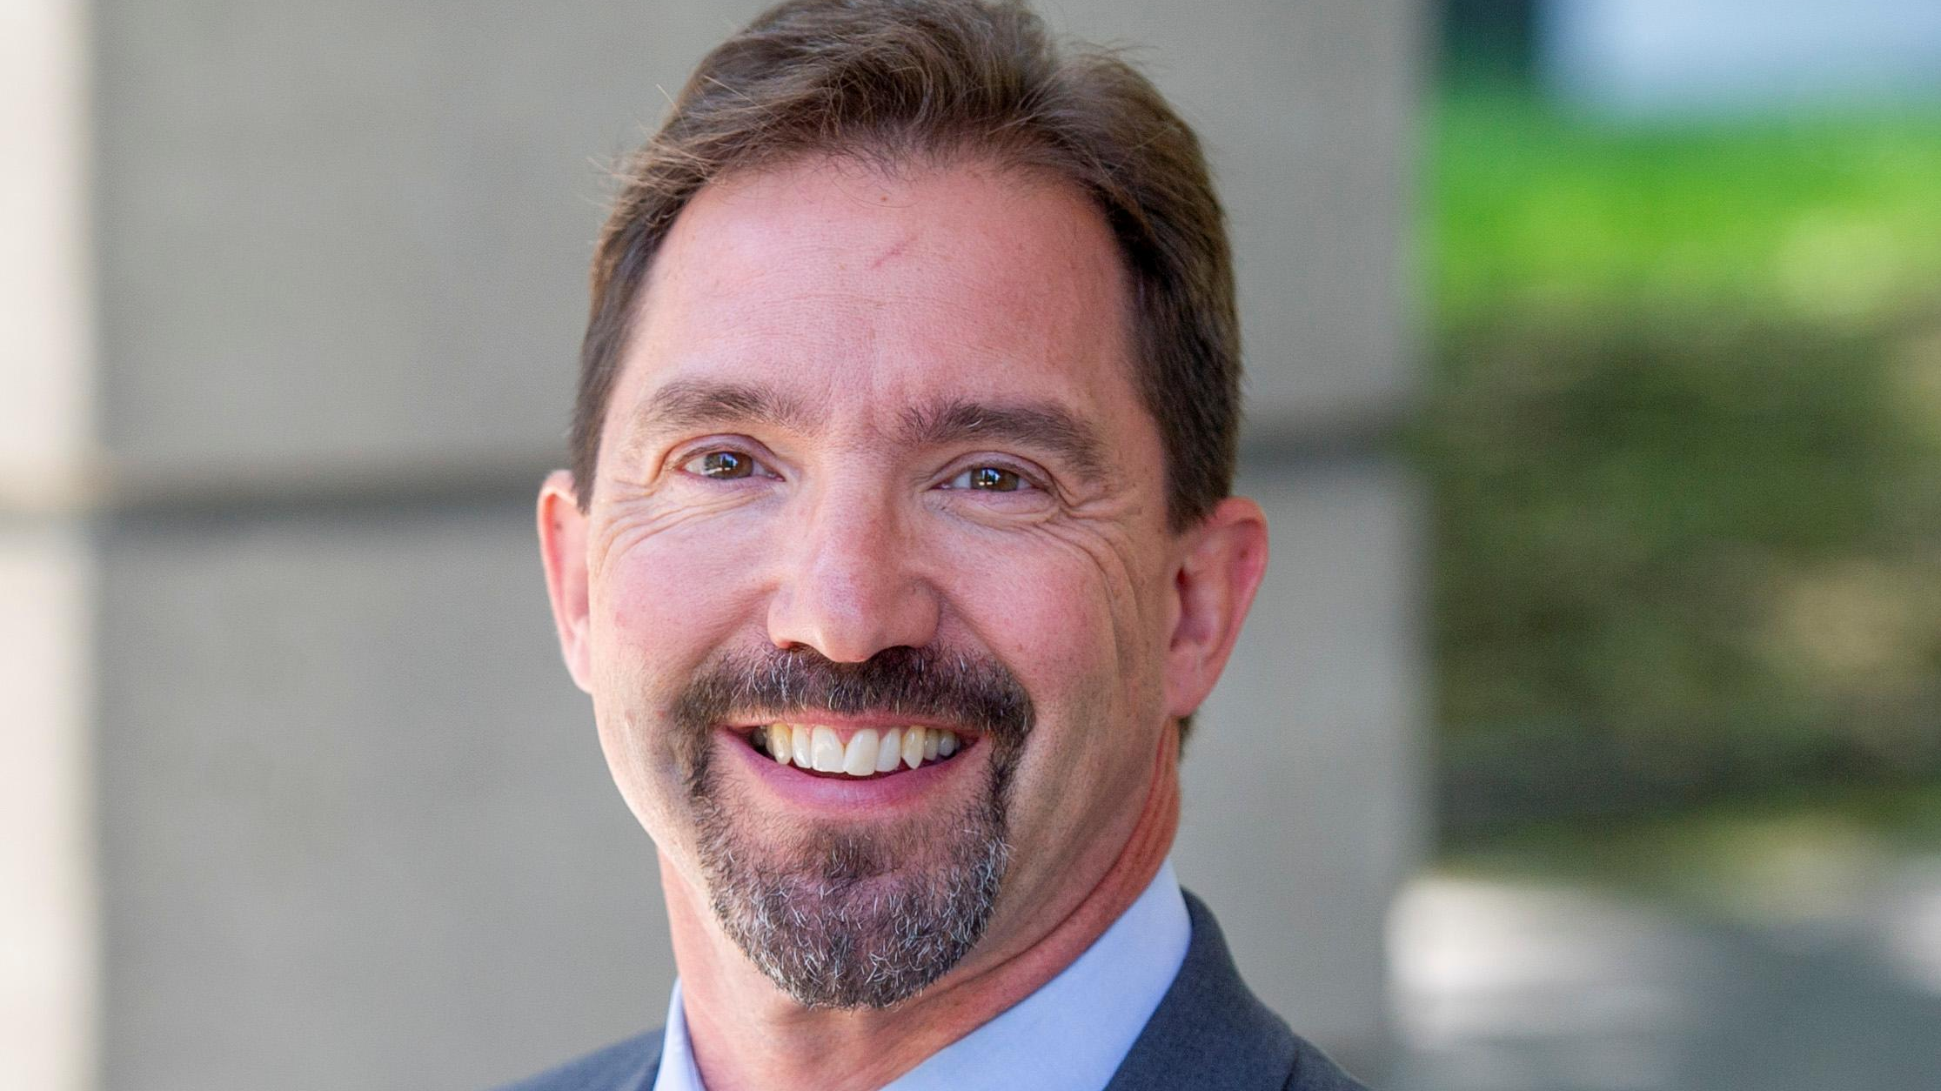
Mark LaVigne, PhD
Deputy Director
NYSAC

Slide 3
NYSAC and the New York Safety Program
Provides Driver Improvement Courses for County Employees.
Supports Employee Safety Programs
Improves Fleet Performance
Personal Point and Insurance Reduction
May Save on Insurance Costs

Slide 4

The Benefit to Your County
Motor vehicle crash injuries on and off the job cost employers almost $60 billion annually between 1998–2000. Employers’ health care (medical) costs of crash injuries were $7.7 billion.
Each year, motor vehicle crashes killed an estimated 2,114 people while they were working and injured 353,000. Crashes cost employers over $24,500 per crash, and over $128,000 per injury.
The Benefits of Drivers Safety Training Include:
Improving Safety for Employees Who Drive County Cars
Saving Taxpayer Dollars by Reducing Accidents
Employees save money on their personal car insurance
Reduce employee absence and vehicle down-time
Improved employee morale

Slide 5

The Costs of Not Using a Driver Safety Program
Crashes can have a devastating impact on a counties financial stability including:
Health Care Costs
Property Damage
Hiring Temporary Employees
Lower Productivity
Impact on Insurance Premiums
Lawsuits
The New York Safety Program can help control these costs and save lives. Your potential savings can be as high as $50,000 per million vehicle miles of travel. Protecting employees from motor vehicle crash injury can be a profitable investment of time and resources.

Slide 6
Everyone Benefits
Individuals can benefit from the actual and potential benefits previously described.
Counties and other organizations in the community can all benefit by offering the course as a member benefit and/or fund-raiser through the county program.
Local governments may save $$$ on vehicle, medical and disability insurance, worker’s compensation, legal expenses, vehicle damage and replacement, recruitment and training costs, and more.
Expand counties’ employee training and risk management program
NYSP have a “train the trainer” program for counties.
Counties can offer driver safety training to your staff and in your communities.

Slide 7
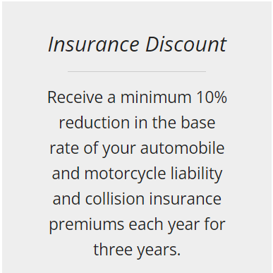
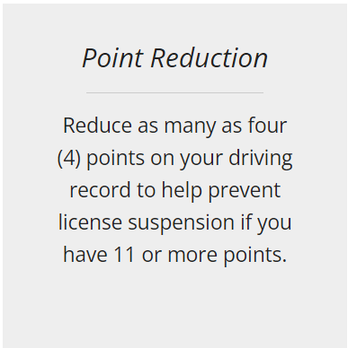
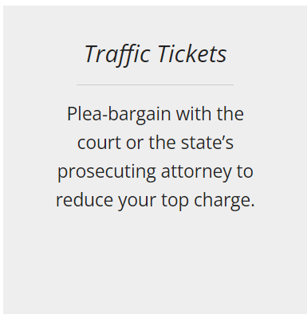
Who is Eligible
County employees
Family members and friends
Drivers of ALL ages
Motorcycle Drivers
Commercial Vehicle Operators
Assigned “risk” drivers
A discount may be applicable for not only the individual driver but the entire fleet of insured vehicles, at the discretion of the insurance provider

Slide 8
Options with NYSP and NYSAC
In Person or Zoom Classes through the county.
  NYSP can train a county official to provide training to your employees
Online Courses
  A. The NYSP Online Course can be found on NYSAC’s website under Member Services
A discount may be applicable for not only the individual driver but the entire fleet of insured vehicles, at the discretion of the insurance provider

Slide 9
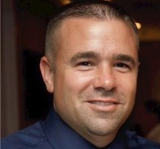

Peter Sadler
Safety Officer
Risk Management Department
Suffolk County

Slide 10

In-Person / Zoom Classes
Become part of the NYSP Team (Train the Trainer)
Why?
Flexibility in providing the course
  At your own location with no minimum number of students
  On your own schedule
  As often as needed
How?
You will need to open a delivery agency and NYSP will train instructors
You will need a classroom facility with a TV and DVD player or access to Zoom meetings
For further information and guidance contact-
  Phone: (800) 942 6874
  E-mail: jzero@nysp.com

Slide 11
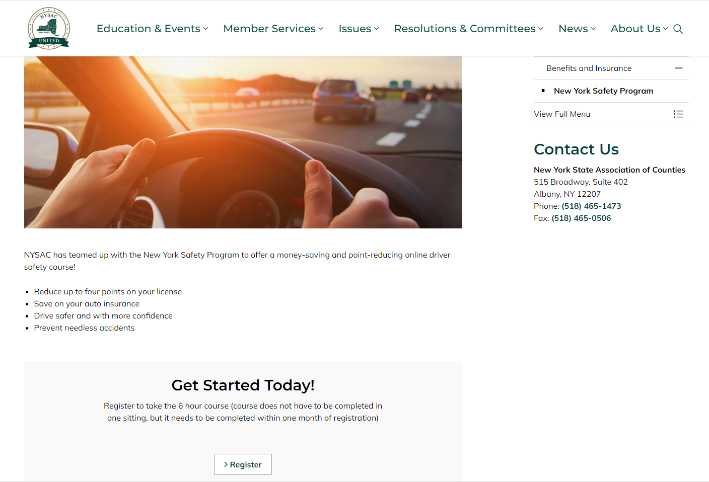
Online Course
The Online Course can be found on NYSAC’s website under Member Services –
Benefits and Insurance
How it works
The course is available for you 24/7, 365 days a year
  The course must be completed within 30 days after you begin
  At the end of each segment, you are able to pause and return where you left off
  The length of the course is five and a half hours
  You will receive a certificate of completion for insurance purposes and NYSP will electronically submit this to DMV for point reduction
Online Course is available to NYSAC members and family at a discounted price
County administrators have an option to pre-pay for its members and NYSP would notify them upon completion

Slide 12
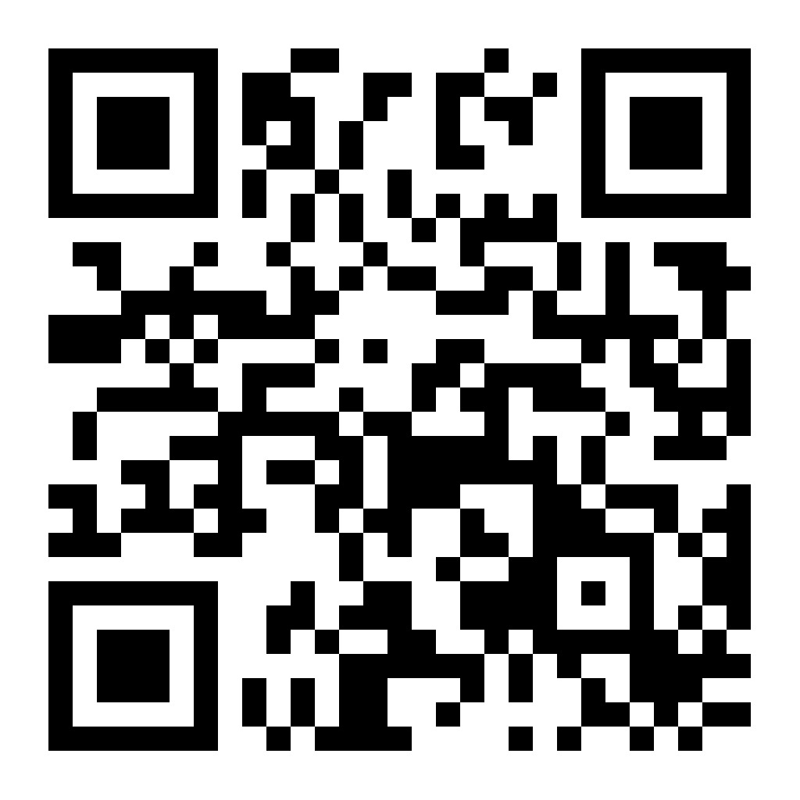
Q & A
Contact Information
New York Safety Program
8302 5th Ave Brooklyn, NY 11209-4511
Tel: 1.718.748.5252
In the NY area: 1.800.942.6874
Fax: 1.718.748.5433
E-mail: jzero@nysp.com

