Slide 1

Workers’ Compensation
Coverage Options
For Lower Costs and Better Coverage
Presented By:
Tony Cassaro, Sr. Sales Executive

Slide 2
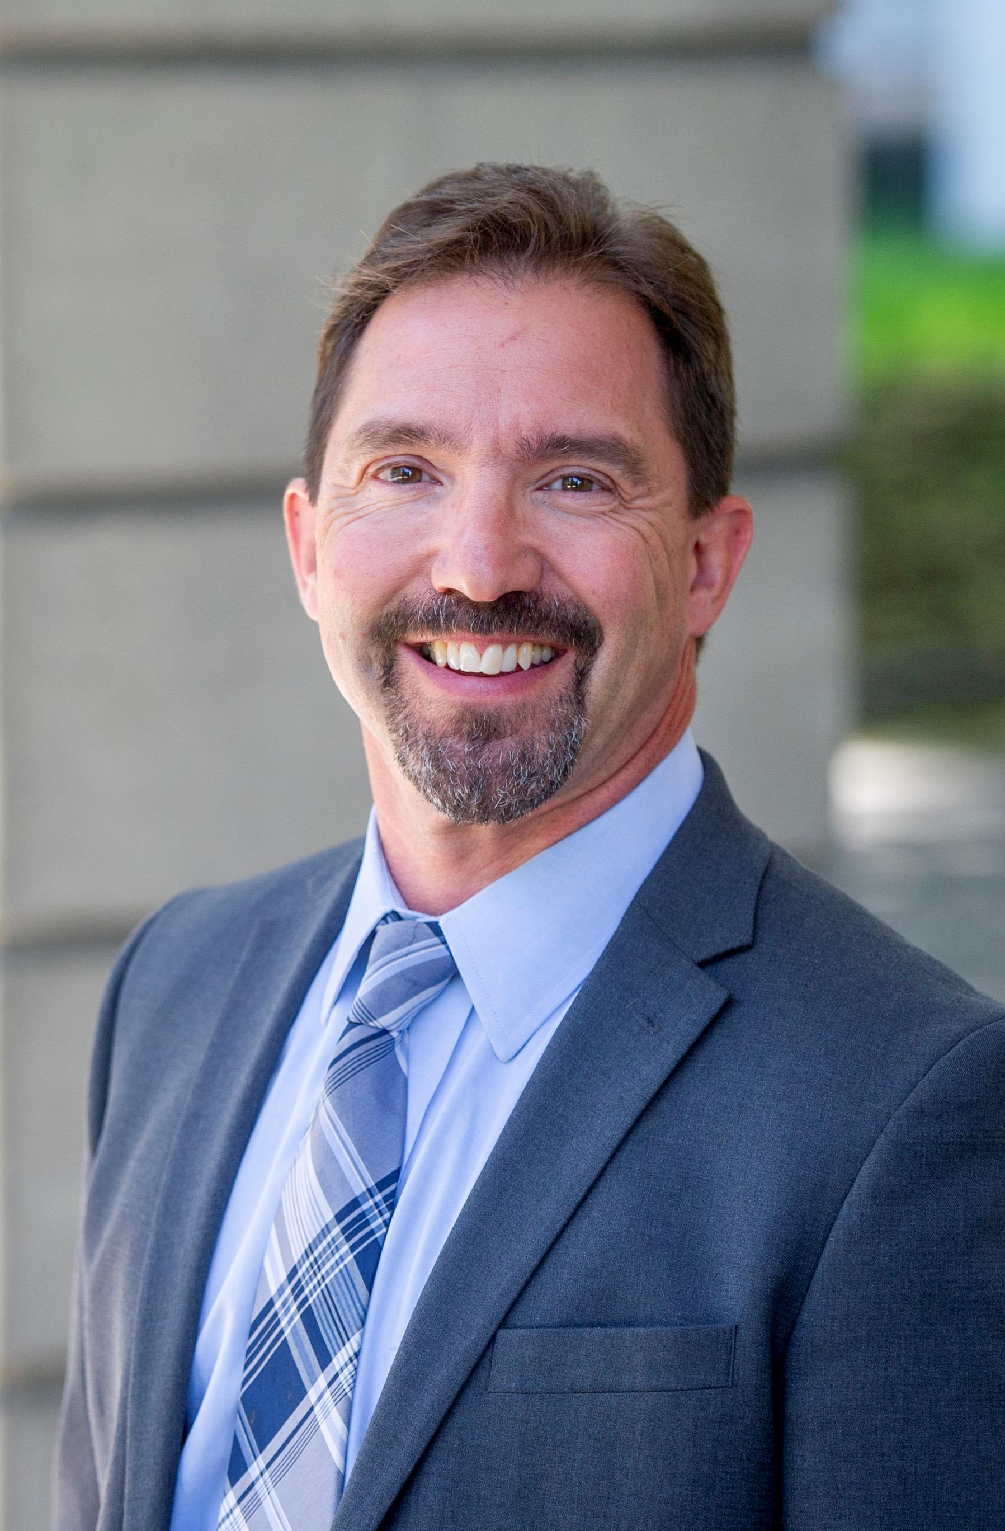

Mark LaVigne, PhD
Deputy Director

Slide 3
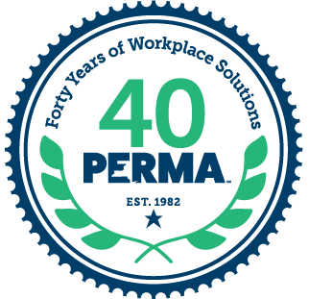

Public Employer Risk Management Association
New York’s largest and most established Workers’ Compensation Pool
Serving over 800 members
  12 Counties (9 unique County groups)
  18 Schools (including one of New York’s largest BOCES programs)
Governed by a Board of Directors
  7 directors elected from membership
  2 appointed from our partner associations
All-inclusive claims administration and risk management services
Notes:
Founded in 1982
including one of NY’s largest BOCES
ED of NYSSBA Bob Schneider is also a board member
-So that comes with the knowledge that our program is endorsed and supported by NYSSBA

Slide 4




Association Partners
Since 2011
Since 2020
Since 2018
Since 2013

Slide 5
Coverage Options
Commercial Insurance Policy
Payment of upfront premium for transfer of risk to an insurance company.
Self-Insurance:
Individual and/or Group Plans
Public entity assumes risk and is ultimately liable for all claims incurred.
Excess Insurance policy must be purchased for coverage of catastrophic claims.
Group Self-Insurance (PERMA)
Transfer of risk to a pool association.

Slide 6
Workers’ Compensation
Self-Insurance
Annual Costs:
  $ Claims costs – Pay as you go with or without funding of claim liabilities.
  $ Third Party Administrator
  $ Excess Insurance
  $ Risk Management and Safety Training
  $ Fraud Services
  $ Legal Services
Rising statutory benefit rates, medical costs, self-insured retentions.
Financial burden due to the development of long-term claim liabilities.
Any additional TPA services are an additional cost.
Revenue for TPA is claim driven.
Notes:
Often unpredictable and vary from year to year
Continually rising cost of excess insurance to protect county from catastrophic claims

Slide 7

Self-Insured Public Entity Pool Coverage
First Dollar
A county and/or an entire county plan located in New York with a taxing authority.
Offers predictable annual fixed rate premium.
Excess Insurance coverage is provided by pool.
Administration and payment of quarterly NYS assessments.
All future risk is transferred to pool, eliminating the financial burden of potentially unfunded claim liabilities.
Notes:
-to include any NYS public school
-we know how important budget predictability is for schools
-that can be around $75 K annually that your district no longer has to budget for
-a NYS fee that you pay to the pool and the pool takes care of the admin involved
-but, at the end of the day, by joining a pool, you are no longer accruing claim liabilites

Slide 8
Overview: NYS Large Deductible Legislation
NYS Legislative bill introduced.
Supported by a variety of public entities including state associations like NYSAC.
Fall 2023:
Signed into law by Governor Hochul
Became effective January 2024.
The bill allows a not-for-profit public group self-insurer to offer public sector members workers’ compensation coverage with a high deductible. This increases workers' compensation solutions for NYS Counties, saving taxpayers money through participation in a larger
group self-insurance program.

Slide 9
Key Provisions: NYS Large Deductible Legislation
The Public Group self-insurer must be fully funded.
There is no joint and several liability within legislation.
High - deductible is a partial risk transfer to group self-insurer for reduced upfront contribution/premium.
Offers budget predictability.
  Counties have often reduced their WC budget and achieved surplus towards future claim development.
Reduction in county long-term claim liabilities through:
  Lower SIR’s / Deductibles
  Proactive claims handling
  Transfer of claims handling expense for lifetime of claims
  Innovative risk management solutions

Slide 10

Self-Insured Public Entity Pool Coverage
Large Deductible
County and/or county plan in New York State with taxing authority.
Counties retain a portion of risk for ongoing cash-flow.
Predictable liability capped per-occurrence.
Deductible is applied to medical and indemnity.
Excess Insurance coverage provided by pool.
Administration and payment of quarterly NYS assessments.
Notes:
-to include any NYS public school
-we know how important budget predictability is for schools
-that can be around $75 K annually that your district no longer has to budget for
-a NYS fee that you pay to the pool and the pool takes care of the admin involved
-but, at the end of the day, by joining a pool, you are no longer accruing claim liabilites

Slide 11

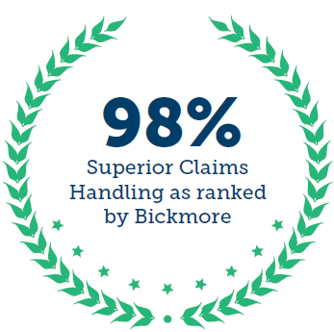
PERMA
Claims Management
Prompt response within
24 hours
In-house claims team
EDI compliance exceeds NYS standard
  SROI compliance of 99% and FROI 94%
Lower than average case-loads
Expert case management
Dedicated Patient Advocate
Modified/Transitional Duty
Subrogation
Fraud prevention & investigation
Timely case resolution
Notes:
contact with employer and injured worker completed within 24 hours of a reported claim
EDI compliance, state avg. is 85%

Slide 12
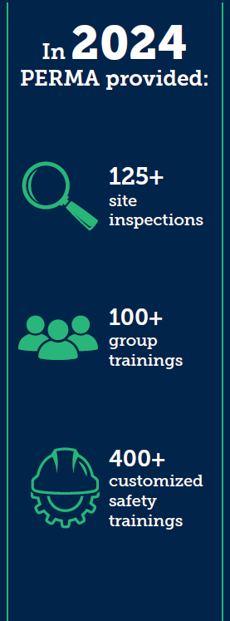
PERMA
Risk Management
Dedicated staff of Risk Management professionals for detailed risk analysis, investigation, and training.
  DPW, Public Safety, School, Regulatory Specialists and a Safety Coordinator
Development of “Safety Culture”
Consultative policy assistance with industry best practices.
Regulatory compliance training and hazard audits
Facility site inspections
Annual safety grant opportunities
PERMA Safety Institute (PSI): Online Learning Platform
Notes:
creating risk profiles, identifying high risk areas and recommending services
, tailored approach for client/member unique risks
-vast Online Library of safety and compliance seminars

Slide 13
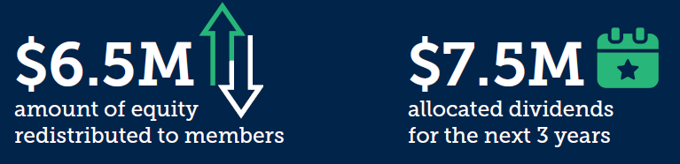

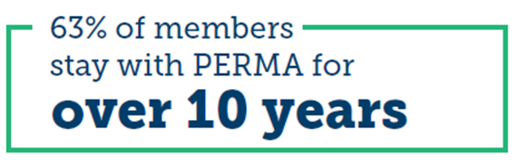
Return on Investment
We continually support and give back to our members through a variety of engagement programs, safety grants and dividends.
Notes:
creating risk profiles, identifying high risk areas and recommending services
, tailored approach for client/member unique risks
-vast Online Library of safety and compliance seminars

Slide 14
Questions?
Tony Cassaro
Sr. Sales Executive
518-220-0324
acassaro@perma.org

